Slide 1
2021 Google Search-Meme Stock Case Study
Are Google Searches a good indicator of meme stock price movement?
Presented By: Jose Felix
Date: 12/12/2021

Slide 2
The Meme Stocks
Affirm Holdings, Inc., Ticker Symbol: AFRM
Palantir Technologies Inc., Ticker Symbol: PLTR
The Beauty Health Company, Ticker Symbol: SKIN
SoFI Technologies, Ticker Symbol: SOFI
Academy Sports and Outdoors, Inc, Ticker Symbol: ASO
Source
Yahoo Article - https://www.insidermonkey.com/blog/5-best-meme-stocks-to-invest-in-978055/
5 Best Meme Stocks to Invest In
Author: Trish Novicio, Yahoo. Keywords: Hedge Funds, News

Slide 3

Google Search
Google Trends history from mid-January to the present tied to a search for the company of interest.
Searches for the terms scaled in proportion from 0-100. The proportion is based on a comparison of other searches/topics on Google.com.
Daily searches is measured by geographic region.
Geography was set to world wide.
Searches made by very few people are set to 0.
Source
Google Trends: www.googletrends.com

Slide 4
The Process
Obtain and Clean the Data
Establish Correlation
Summary of Observations
R Programming Language
Stock prices were obtained from Yahoo Finance using the tidyquant library.
Google search data obtained using GtrendsR library from Google Trends.
Combine data to view correlation
R & Tableau
Correlation data between the variables.
A table of correlation values obtained using R.
Visualization of correlation variables using Tableau.
No Correlation
After careful analysis of the data and the visualizations we conclude that using Google search trends will NOT produce a profitable strategy for daily stock trading.

Slide 5
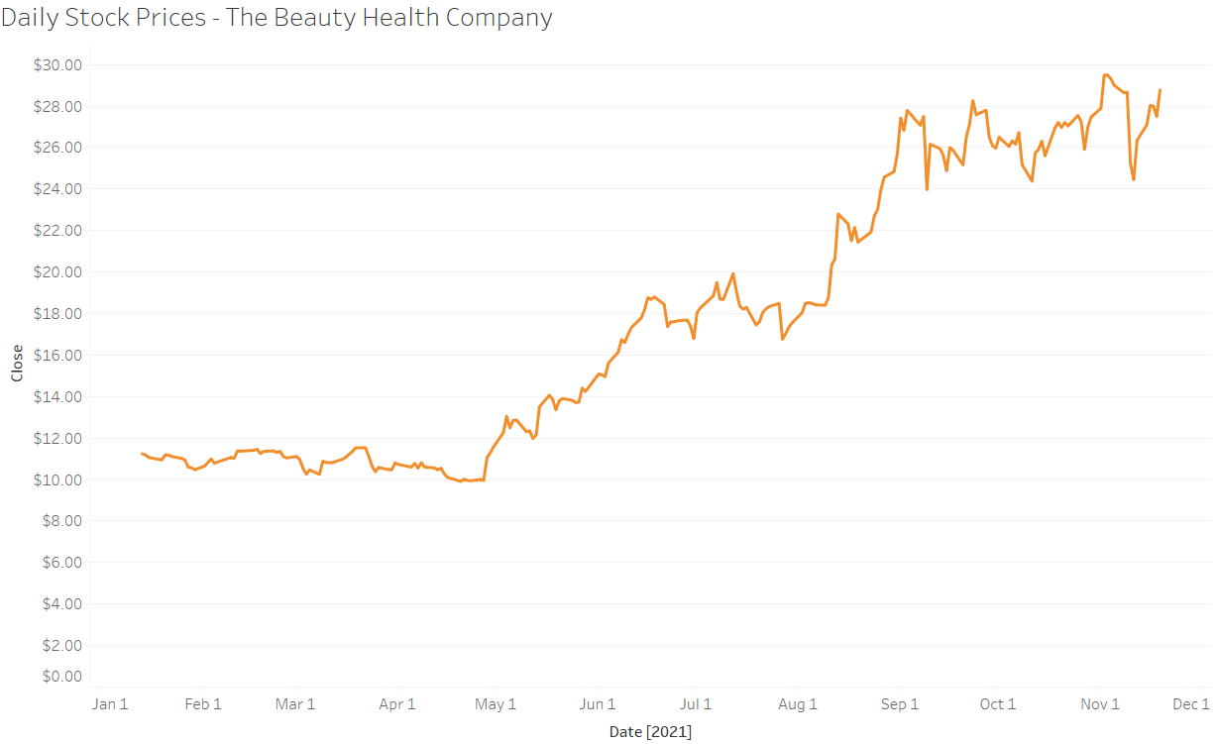
Stock Prices
Initial Values: Date, Open Price, Highest Price, Lowest Price, Closing Price, Volume, Adjusted Stock Price
Added Values: Price Change Percentage and Price Change
Link to interactive visualization.

Slide 6
Google Trends
The initial values are helpful but two additions are needed. Previous day’s hits on each row could be a valid data point as well as adding a ticker symbol. The ticker symbol can be used to join this data set with the stock price dataset using a common data key.
Date Hits Previous_hits Company Ticker
1 2021-01-12 0 0 The Beauty Health Company SKIN
2 2021-01-13 0 0 The Beauty Health Company SKIN
3 2021-01-14 0 0 The Beauty Health Company SKIN
4 2021-01-15 0 0 The Beauty Health Company SKIN
5 2021-01-16 0 0 The Beauty Health Company SKIN
6 2021-01-17 0 0 The Beauty Health Company SKIN
Initial Values: Date, Hits, Company
Added Values: Previous Day Hits, Ticker Symbol
Link to Google Trends

Slide 7
Consolidated data for analysis
Symbol | Date | Open | High | Low | Close | Volume | Adjusted Close Price | Change (Absolute) | Percent Change | Prev Day Hits | Hits | Keyword
SKIN | 1/13 | 11.10 | 11.40 | 11.02 | 11.24 | 973200 | 11.24 | 0.14 | 1.261261 | 0 | 0 | The Beauty Health Company
SOFI | 1/13 | 18.90 | 19.59 | 18.53 | 19.11 | 8226400 | 19.11 | 0.21 | 1.111116 | 0 | 0 | SoFI Technologies
ASO | 1/13 | 22.61 | 23.24 | 21.65 | 22.03 | 707600 | 22.03 | 0.58 | 2.565237 | 0 | 23 | Academy Sports and Outdoors
PLTR | 1/13 | 25.71 | 27.43 | 25.13 | 25.50 | 51216600 | 25.50 | 0.21 | 0.816799 | 0 | 35 | Palantir Technologies
AFRM | 1/13 | 90.90 | 103.00 | 90.01 | 96.36 | 25159000 | 96.36 | 5.46 | 6.012097 | 0 | 19 | Affirm Holdings

Slide 8
Correlation
In statistics, it is the statistical relationship between two variables. It is how they move in relationship to each other.
Correlation can be positive or negative. The strongest correlations are 1 or -1
High correlation greater than or equal to 0.50
Moderate correlation between .30 and .49
Weak or no correlation is less than .30
The conditions above can be positive or negative.

Slide 9
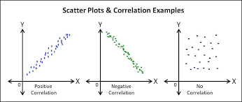
Scatter Plots and Correlation
Source: http://trailhead.salesforce.com

Slide 10
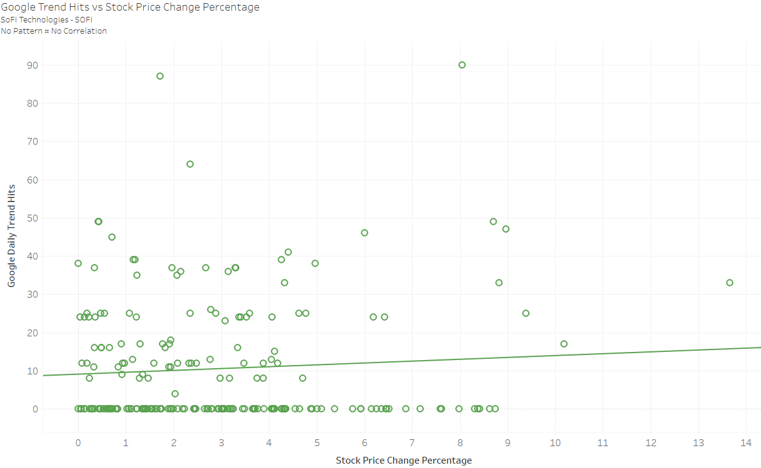
SoFI Technologies - Very weak correlation
Previous day hits correlation to Price Change = -0.18 | Daily hits correlation to Price Change = 0.019

Slide 11
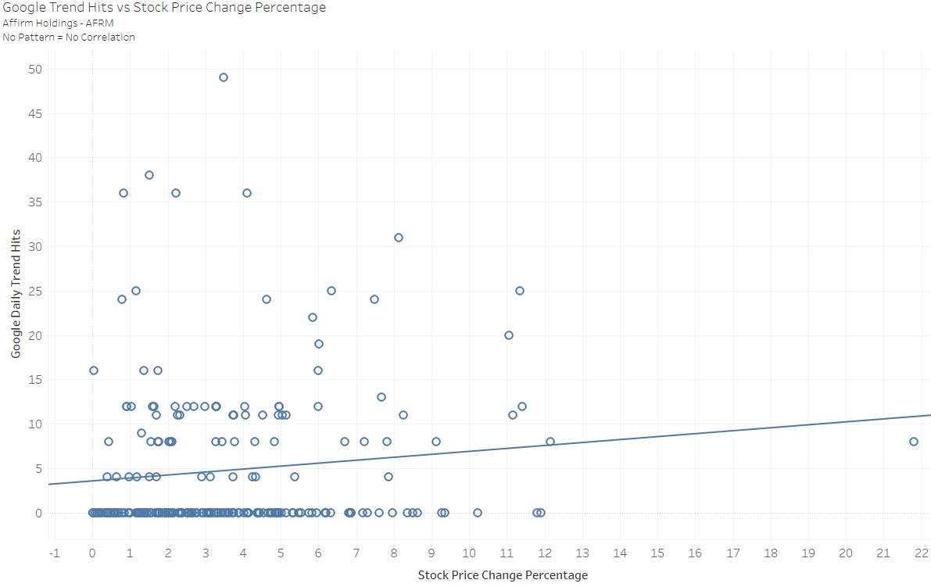
Affirm Holdings - Almost moderate correlation
Previous day hits correlation to Price Change = 0.055 | Daily hits correlation to Price Change = 0.268

Slide 12
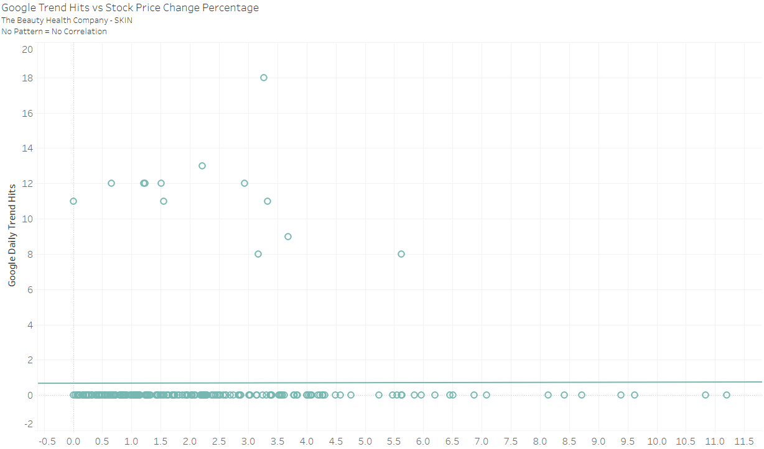
The Beauty Health Company - Very weak correlation
Previous day hits correlation to Price Change = .022 | Daily hits correlation to Price Change = 0.024

Slide 13
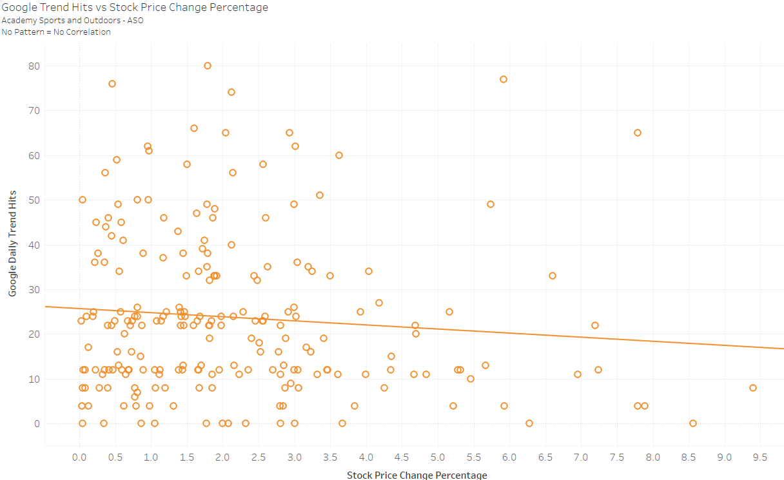
Academy Sports and Outdoors - Very weak correlation
Previous day hits correlation to Price Change = -0.07 | Daily hits correlation to Price Change = -0.100

Slide 14
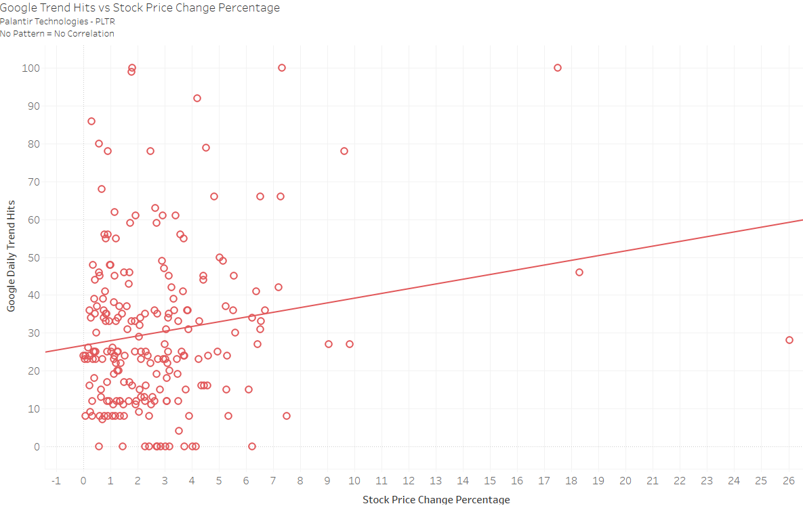
Palantir Technologies - Weak correlation
Previous day hits correlation to Price Change = 0.066 | Daily hits correlation to Price Change = 0.211

Slide 15
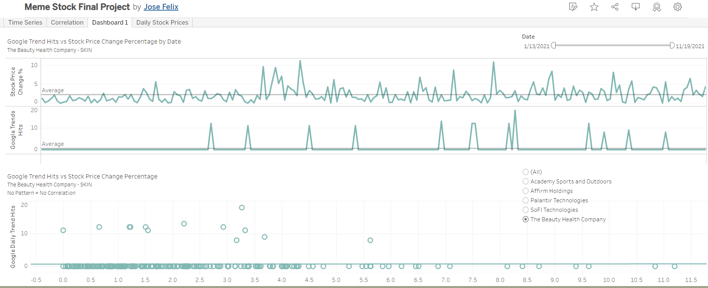
Time Series Dashboard available on Tableau
Filters available by company and time for further study and analysis.

Slide 16
Summary
Correlation was poor for all stock prices based on Google search hits.
Volume was more closely correlated than any other variable as far as financial metrics are concerned.
Dashboard showing a time series available on https://public.tableau.com/app/profile/jose.felix/viz/MemeStockFinalProject/Dashboard1.
Google search trends should not be used as a leading indicator for any trading strategy

Slide 17
Recommendations
Use of other online sources for interest may be better.
Reddit
Twitter

